Slide 1
Integration Testing
Module 2: 08

Slide 2
Objectives
Integration Testing
Common Test Database Approaches
Testing DAOs
DAO Testing Workflows
Handling Test Data
Transaction Scope
DataSource
Integration Testing Life Cycle
Verifying Results
Truncating Data

Slide 3
Integration Testing
Integration Testing is a broad category of tests that validate the integration between units of code or code and outside dependencies such as databases or network resources.
Integration tests in Java
Use the same tools as unit tests (i.e. JUnit)
Usually slower than unit tests
More complex to write and debug
Can have dependencies on outside resources like files or a database

Slide 4
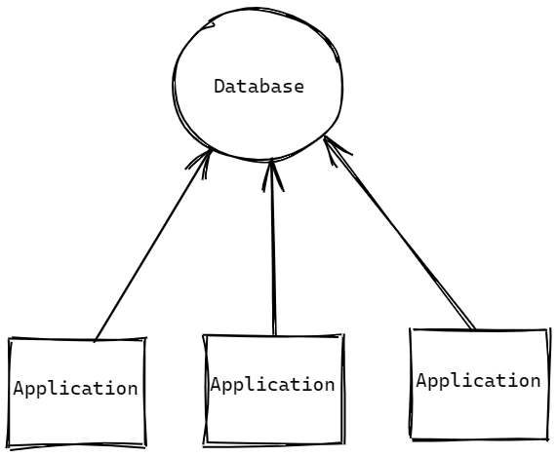
Test Database Approaches - Shared Database
All Developers share a remote test database on the network.
Pros:
Easy Developer setup
1 Setup for all developers
Production-like software and hardware
Can be managed by DBAs
Cons:
Unreliable
Brittle
No Isolation
Temptation to rely on existing data

Slide 5
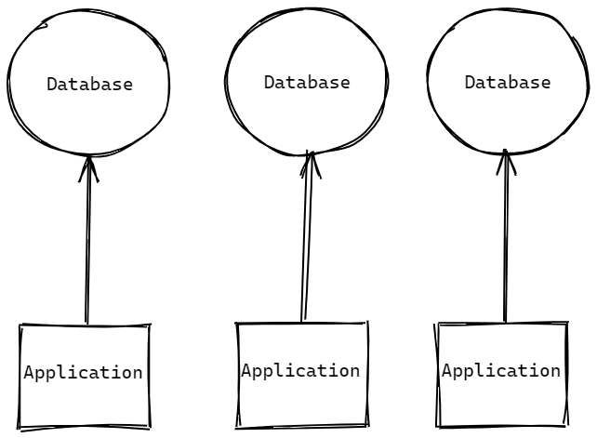
Test Database Approaches - Local Database
Each developer has their own copy of the database on their computer.
Pros:
Production-like software
Reliable
Isolation
Cons:
Requires developer to act as DBA
RDBMS needs to be installed locally, requiring additional licences
Hardware is not production like
Production like data can be difficult
Inconsistent across machines

Slide 6
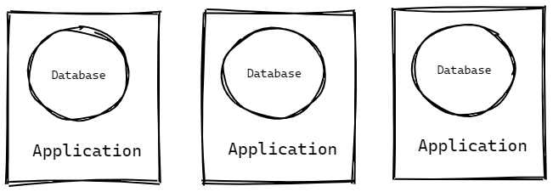
Test Database Approaches - Embedded Database
An in-memory database server is started and managed by test code and run inside the application
Pros:
Very reliable
Consistent across machines
Lightweight
Supports Continuous Integration
Cons:
Software and hardware is not production like
Can not use proprietary features of an RDBMS
Production like data can be difficult

Slide 7
DAO Testing
Integration Testing Workflow Cheat Sheet
Integration tests should be:
Repeatable: If the test passes/fails on first execution, it should pass/fail on second execution if no code has changed.
Independent: A test should be able to be run on it's own, independently of other tests, OR together with other tests and have the same result either way.
Obvious: When a test fails, it should be as obvious as possible why it failed.
Integration should never use existing data. It should always provide its own.
Integration can use other DAO methods to Arrange or Assert, but only from the DAO being tested. If a method doesn’t exist in the DAO being tested them the JdbcTemplate should be used.

Slide 8
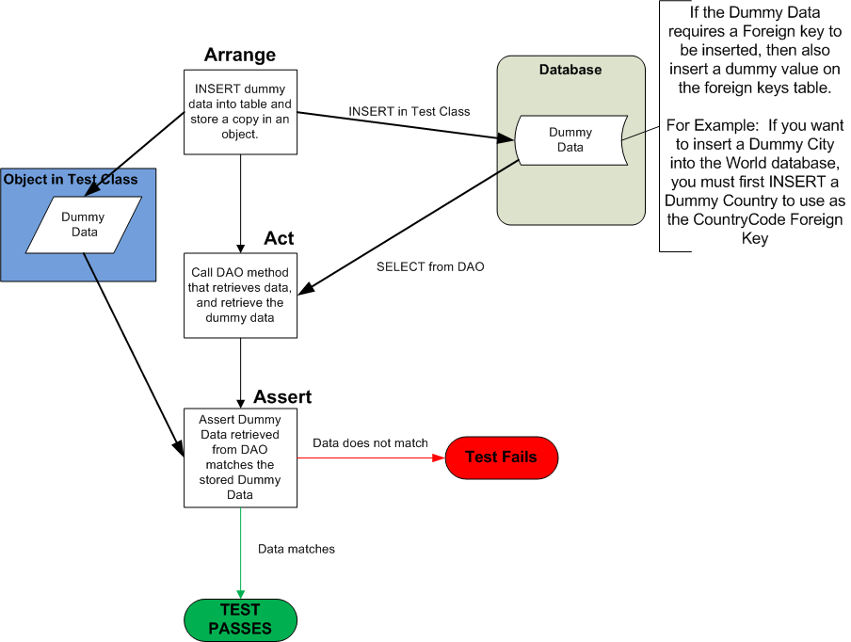
Integration Testing SELECT
ARRANGE: Insert dummy data using either the DAO or the JdbcTemplate
ACT: Select the dummy data using the DAO
ASSERT: Verify the data returned is the same as what was inserted.

Slide 9
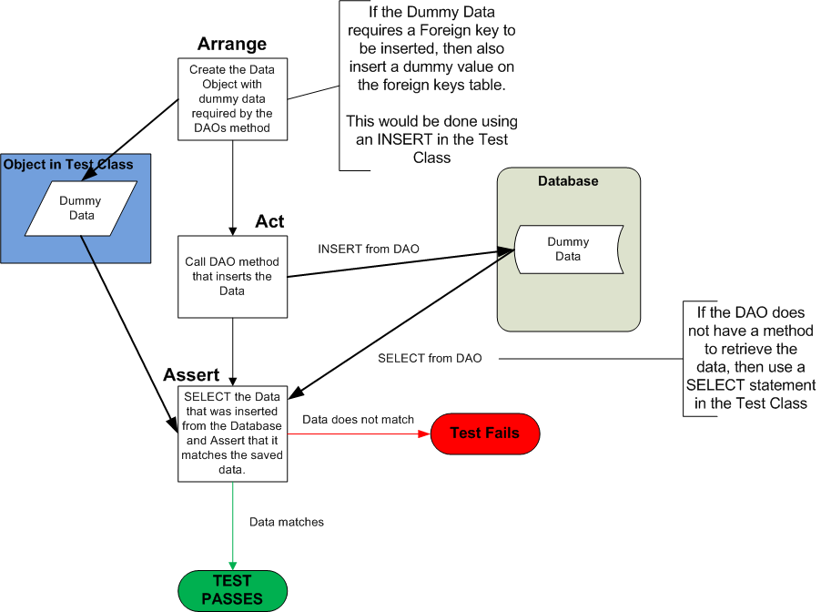
Integration Testing INSERT
ARRANGE: Create a Data Object with dummy data
ACT: Insert the dummy data using the DAO
ASSERT: Select the inserted data either using the DAO or the JdbcTemplate. Verify that what was selected matches what was inserted

Slide 10
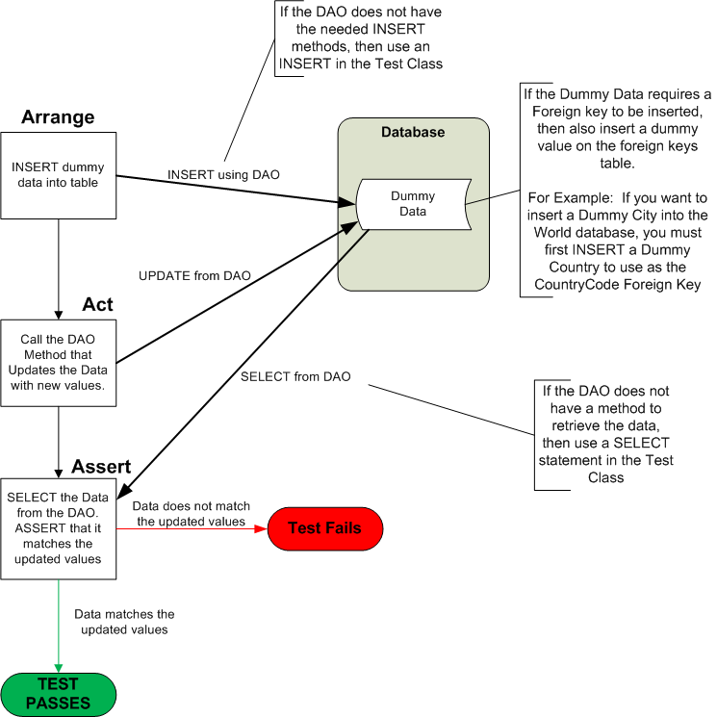
Integration Testing UPDATE
ARRANGE: Insert dummy data using the DAO or JdbcTemplate.
ACT: Update the dummy data using the DAO
ASSERT: Select dummy data using either the DAO or JdbcTemplate and verify the change was made.

Slide 11
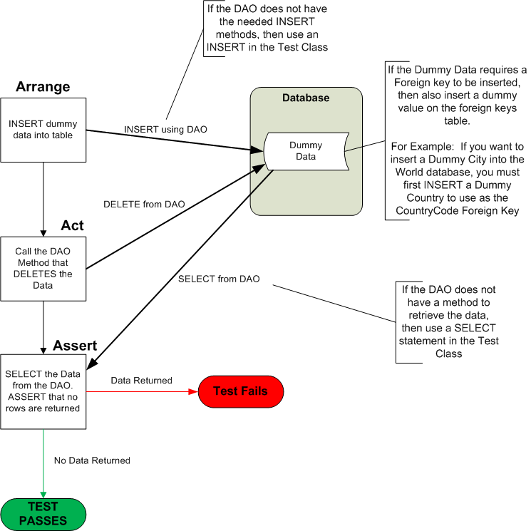
Integration Testing DELETE
ARRANGE: Insert dummy data using the DAO or JdbcTemplate.
ACT: Delete the dummy data using the DAO
ASSERT: Select dummy data using either the DAO or JdbcTemplate and verify that it no longer exists.

Slide 12
Integration Test Data
Integration Tests should NEVER use existing data!
Dummy data required for the test should be inserted into the database as part of the Arrange of the test. Methods in the DAO being tested can be used, however, methods from other DAOs may not be used. If no method exists in the DAO being tested then the JdbcTemplate should be used.
If a test needs a list of items, then multiple dummy entries should be added.
If dummy data has a foreign key relationship, then a dummy related item should be created to use as the foreign key. And if the related entry has a foreign key of its own, then dummy data for that key should be inserted, and so on….
For example: To test a City in the World database, then a dummy city should be inserted, but city has a foreign key relationship on country, so a dummy country should be inserted to use as the foreign key for the city. Now imagine if country had a foreign key relationship on region, then a dummy region should be inserted to use as the foreign key on the dummy country.

Slide 13
Transaction Scope
After the test is run the database and data should be in the same state as before the test was run.
Transactions will be used to create an automatic transaction scope that will start a transaction before each test is run and rollback after each test has completed. This will prevent the database from being permanently changed during testing.

Slide 14
Integration Test Data Source
Our DAOs used the BasicDataSource from Apache’s DBCP2 library, which provided a connection pool. Since we need to create a Transaction scope, a connection pool will not allow steps in our tests to see the changes made by other steps.
For testing we will use the SingleConnectionDataSource, which will create a direct connection without a connection pool, allowing steps to share the connection, and see changes being made by other steps.
Since the SingleConnectionDataSource is not a connection pool, the connection must be closed after all tests have been run.

Slide 15
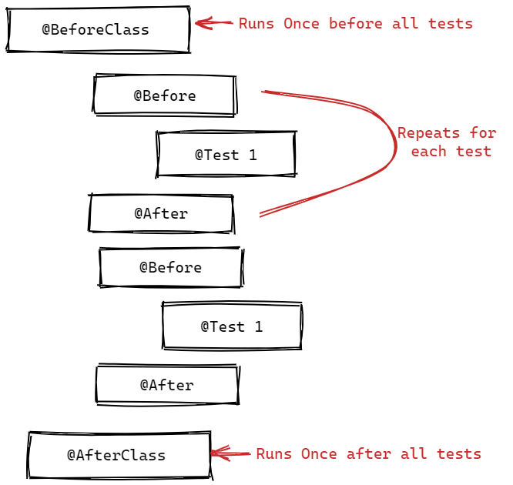
Integration Test Life Cycle
@BeforeClass - runs once before all tests. Creates the DataSource and enables Transaction Scope (autocommit=false)
@Before - runs before each test for common Arrange steps
@Test - the test
@After - runs after each test. Rollback transaction
@AfterClass - runs once after all tests complete. Destroy the DataSource.

Slide 16
Verifying Results (Assert)
During Integration testing we must be careful to test our DAO and NOT THE RDBMS (Database) or DATA.
In Unit Testing methods are being tested which have an absolute value that maybe asserted. Often in Integration testing absolute values will be tedious and quickly lead us to testing the RDBMS. To avoid this we look for what we can Assert that reasonable proves that our test worked.
For example, if testing an method that inserts 5 items. We may get the count of rows on the table before the insert. Call the methods that inserts the 5 items for the test, then to Assert that it happened, get a count of rows on the table after the method ran and Assert that it is the original row count + 5.

Slide 17
Truncating Data
Sometimes the unknown data on a table may cause problems for our tests. In this case, we can truncate the data from the table. Truncate is like the DML delete, but it is a DDL command, but it can remove all the data without maintaining integrity of the table. DELETE should be used when specific records need to be removed, and TRUNCATE when all records need to be removed.
TRUNCATE city; ← removes all records from the city table. It will have an error if a foreign key relationship exists. TRUNCATE city CASCADE; ← removes all records from the city table, and all records from other tables that have a foreign key relationship.
TRUNCATE… CASCADE can have undesired results. For example, in the City database, if you TRUNCATE country CASCADE it will remove all records from every table in the database!
In a working environment ALWAYS check with your team if TRUNCATE is allowed as part of integration testing. Many teams do not allow its use due to an increase risk of data loss if the Transaction is not properly rolled back.

